Slide 1
Unleashing the Power of Data:
Understanding and Predicting Wildfire in Canada
Jelilat Adebayo
Victor Olatope
Olayinka Mogaji
Cindy Dai

Slide 2



PROJECT TEAM
Jeliliat
Olayinka
Victor
Cindy
Project Background, Dataset and Workflow
Exploratory Data Analysis
Predictive model, Summary and next step
Factors Driving Wildfire Spread

Slide 3
Canadian Wildfire?
Wildfires are of considerable public concern and present a risk to public safety, communities, and critical infrastructure.
The impact cut across different scales of our ecosystem with attendant financial implications
The 2023 wildfire underscores the scale of impact they could have
Risk to human life property damage, transportation impacts
Local scale effects
Soil erosion, timber/crop loss, water quality degradation, habitat reduction
Landscape/watershed effects
Health impact, reduced air quality, decreased tourism
Regional scale effects
Government expenditure for fire risk mitigation, planning, suppression, remediation
National scale effects
Temporary shifts in weather patterns, air travel disruption
Global scale effects

Slide 4
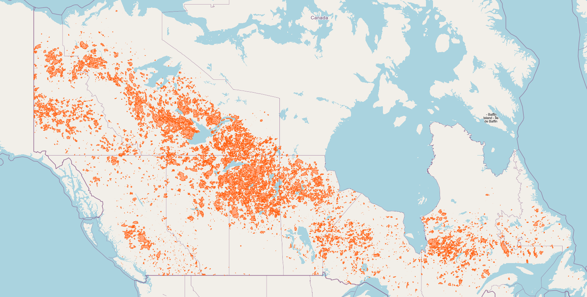
Satellite View of Wildfire
Map shows satellite view of wildfires between 1990 – 2021
Size of the polygons show the extent of the fires
Most occurred within a belt trending from NW to SE
Northwest Territories
Nunavut
Yukon
British Columbia
Manitoba
Newfoundland and Labrador
Alberta
Saskatchewan
Ontario
Prince Edward Island
Quebec

Slide 5
Project Goal and Objective
As project goal, we achieved the following objectives through exploratory analysis and machine learning model:
Identified the primary drivers of wildfire and its severity in Canada.
Visually presented the geographical location that are less susceptible to wildfire, which can inform investment decisions.
Identified the periods during which wildfires are most likely to occur.
Predicted the likelihood of wildfires based on Vegetation index, Land Surface Temperature, and Burn area.

Slide 6
Dataset and Wrangling Steps
Name | Dimension (Row, Columns) | Description | Source | Data Accessed
Number of fires | 1060, 11 | Number of fires grouped by month, causes, and fire size | National Forest Database | 11th July 2023
Area burned | 1060, 11 | Total area burned grouped by month, causes, and fire size | National Forest Database | 11th July 2023
National Burned Area Composite | 36917, 20 | Contains polygons of the area burnt and causes of fire | Canadian wildfire Datamart | 11th July 2023
Weather data |  | Weather data by stations in Canada at daily level | Daily weather data | 20th July 2022
Wildfire prediction | 1714, 5 | Contains land surface temperature, vegetation index and burn area | Wildfire | 20th July 2022
**All data are publicly available, hence no legal restriction on the usage
~4GiB of data used for the analysis
Process parallelization was deployed to improve the weather data download process
All data filtered to cover only 1990 to 2021 (due to the coverage of the National Burned Area polygons)
Files in “SHP” format converted to “CSV” format for ease of handling and analysis in AWS environment
Data quality and tidiness issues were addressed
The final cleaned data were loaded into an AWS S3 bucket.

Slide 7
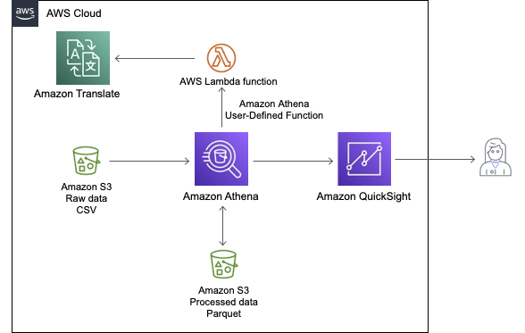




Project Workflow
AWS Athena was leveraged to query and streamline data in readiness for visualization
AWS QuickSight used for creating visualization dashboards
Spatial polygons of wildfires (based on satellite images) analyzed using ArcGIS Pro (student license)
Actionable insights from these steps underpinned the machine learning model for predicting wildfire risk.
Download data files
Files in “SHP” format converted to “CSV”
Others in “CSV” format loaded directly
“SHP” files loaded into ArcGIS to view satellite images of burned areas
Esri
Publish view to ArcGIS online
ArcGIS Pro
ArcGIS Online

Slide 8

Exploratory Data Analysis

Slide 9
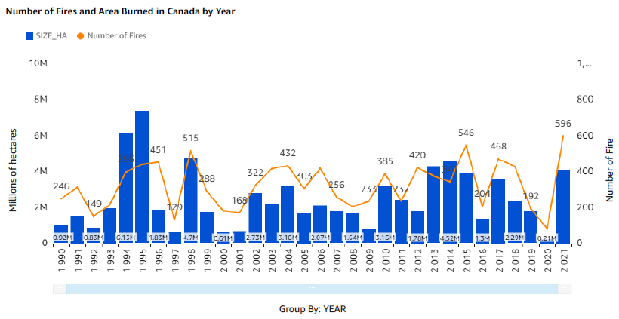
Number of Wildfire and Area Burned
COVID-19 year! There were restricted human movement
Years with the highest burned area:
1995 with 7,341,266.05
1994 with 6,126,773
1998 with 4,700,518.54
Years with the lowest burned area:
2020 with 206,152.71
2000 with 613,143.18
1997 with 615,973.28
The number of fire has averaged around 470 annually; lowest was in 2020 and highest in 2021.
In 2020, human movements were restricted due to COVID-19 pandemic – this raises a question: does human movement have direct link to wildfire causes?
The plot also suggests that there is some direct correlation between the number of wildfire and the size of area burned.

Slide 10
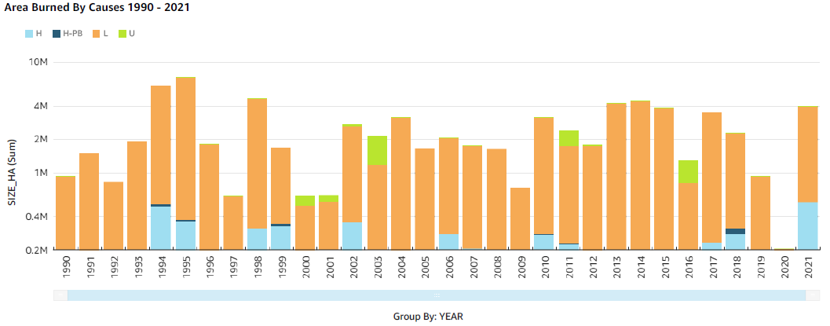
Area Burned by Causes
H: Human
H-PB: Human Prescribed Burn
L: Lightning
U: Unknown
COVID-19 year! There were restricted human movement
Human activities does contribute to the wildfire disasters in Canada, but the proportion of area burns is low when compared with that caused by lightning.
The year 2020 still leaves a curious case as to if restricting human movement can reduce wildfire occurrence or there was limited data acquisition
Prescribed burns are intentional fires set by the government to manage and control the spread of wildfires.

Slide 11
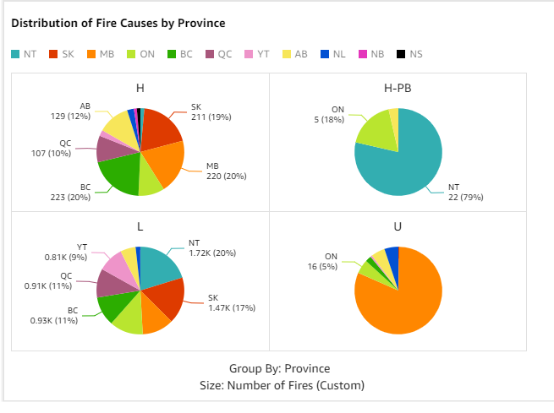
Distribution of Fire Causes by Province
H: Human
H-PB: Human PB
L: Lightening
U: Unknown
Human: the largest proportions are in BC, MB and SK with 20%, 20% and 19% respectively
Lightning: the largest occurrence in NT (20%), followed by SK (17%). BC, QC and YT also have considerable proportion
Prescribed burning in largest in NT (79%)

Slide 12
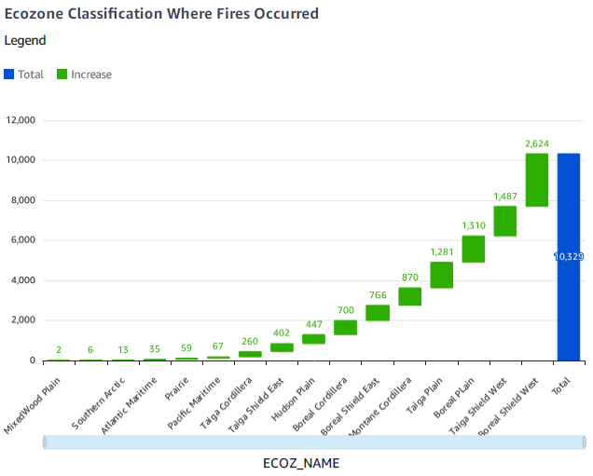
Distribution of Fire Causes by Ecozone
Top zones where wildfire have occurred most: Boreal Shield West, Taiga Shield West, Boreal Plain
Areas where wildfire have least occurred: Mixed wood plain, Southern Arctic, Atlantic Maritime

Slide 13
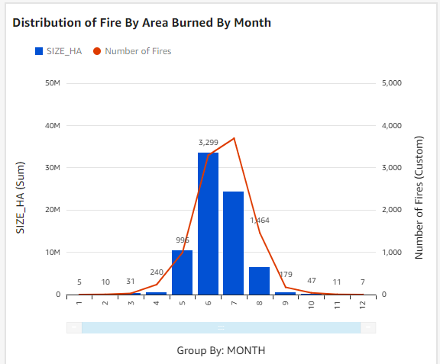
Distribution of Fire Causes by Months
Plot shows counts of wildfire by months of occurrence and the total area burned
The curves have normal distribution; most of the first occur between May – August
This is expected due to weather conditions around this period, e.g., high temperature

Slide 14
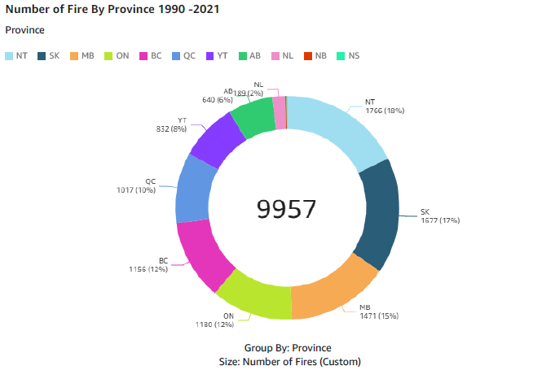
Frequency of Wildfire by Province
Plot shows frequency of wildfire by the province
NT has the highest frequency (18%), followed by SK (17%) and MB (15%)
NB, NU, PE and NS have the least or no occurrence of wildfires
Next section will focus on the factor that underpinned this disparity

Slide 15
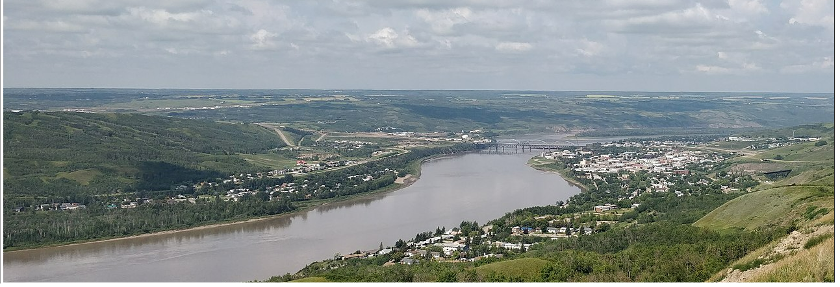
Factor Driving Fire Spread

Slide 16
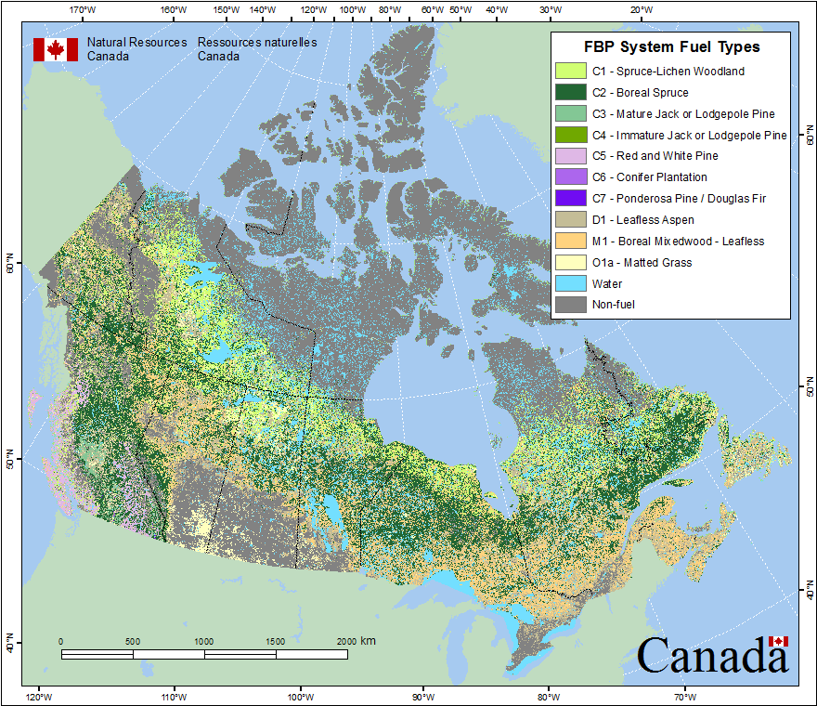
Mapping of Fuel Types
Northwest Territories
Yukon
The map of fuel types derived from forest attribute data (Beaudoin et al 2014)
Fuel types were assigned based on vegetation type, tree species, crown closure, and other attributes.
Forest fire occur mostly across the area with dense concentration of fuel
British Columbia
Newfoundland and Labrador
Quebec
Alberta
Saskatchewan
Manitoba
Ontario
Prince Edward Isl
New Brunswick
Nova Scotia

Slide 17
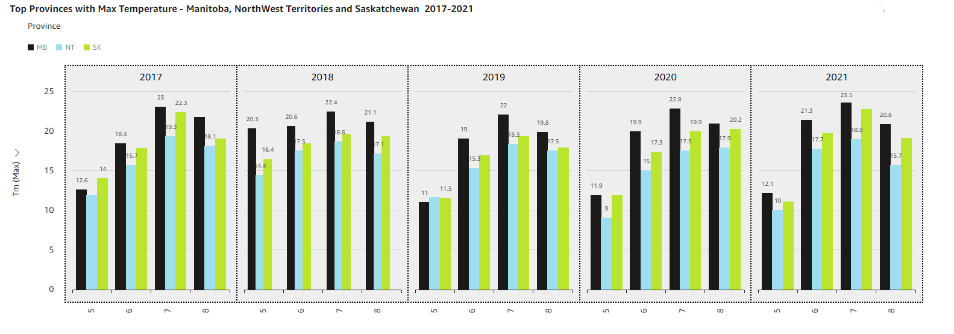
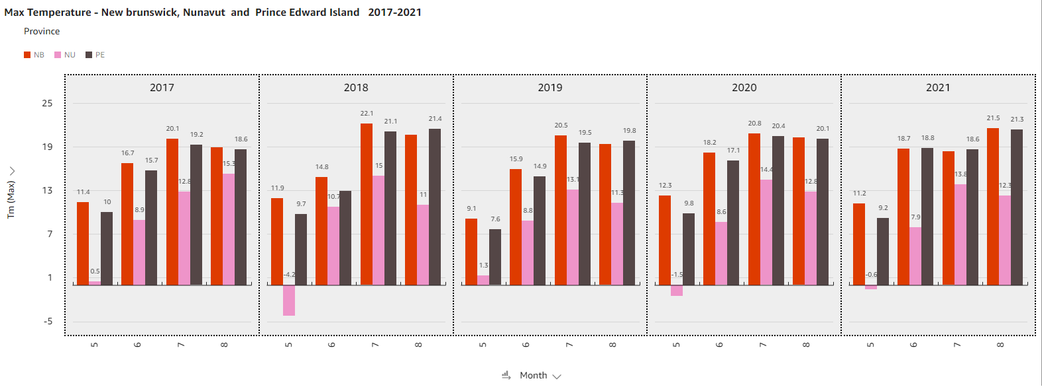
Max Temperature Comparison
Plots show comparison of max monthly temperature for top 3 and bottom 3 province wrt number of wildfire occurrence
This covers only spring to summer times only
Average month-by-month temperature higher in the top 3 provinces compare to that from the bottom 3 provinces

Slide 18
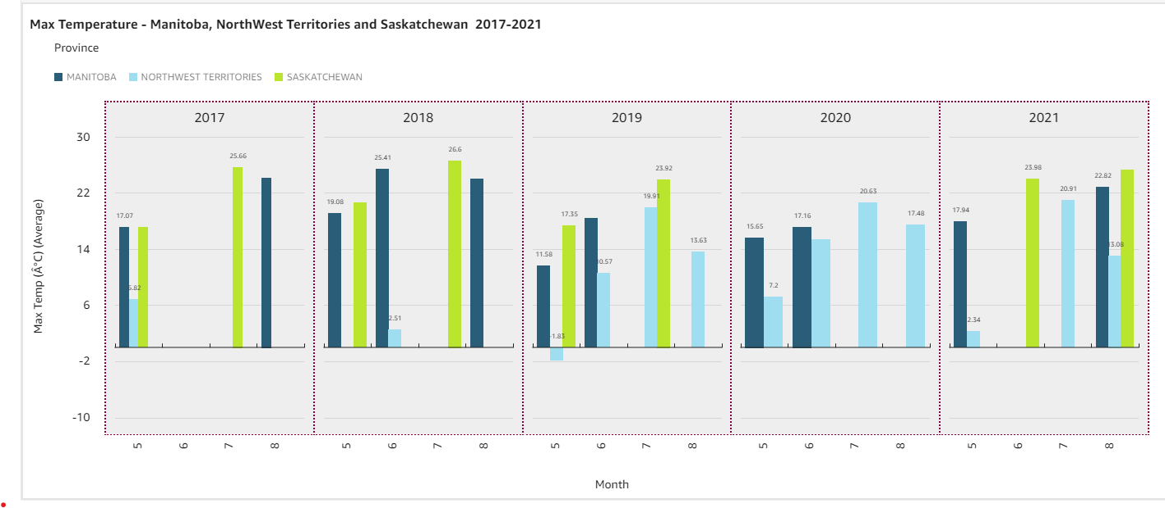
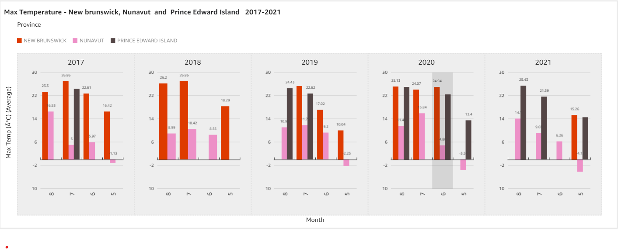
Precipitation Comparison
Plots show comparison of total precipitation per month for top 3 and bottom 3 province wrt number of wildfire occurrence
Precipitation is a measure of total liquid that percolate into the soil
This covers only spring to summer times only
There seems to be more frequent precipitation in the bottom 3 than in the top 3 provinces

Slide 19
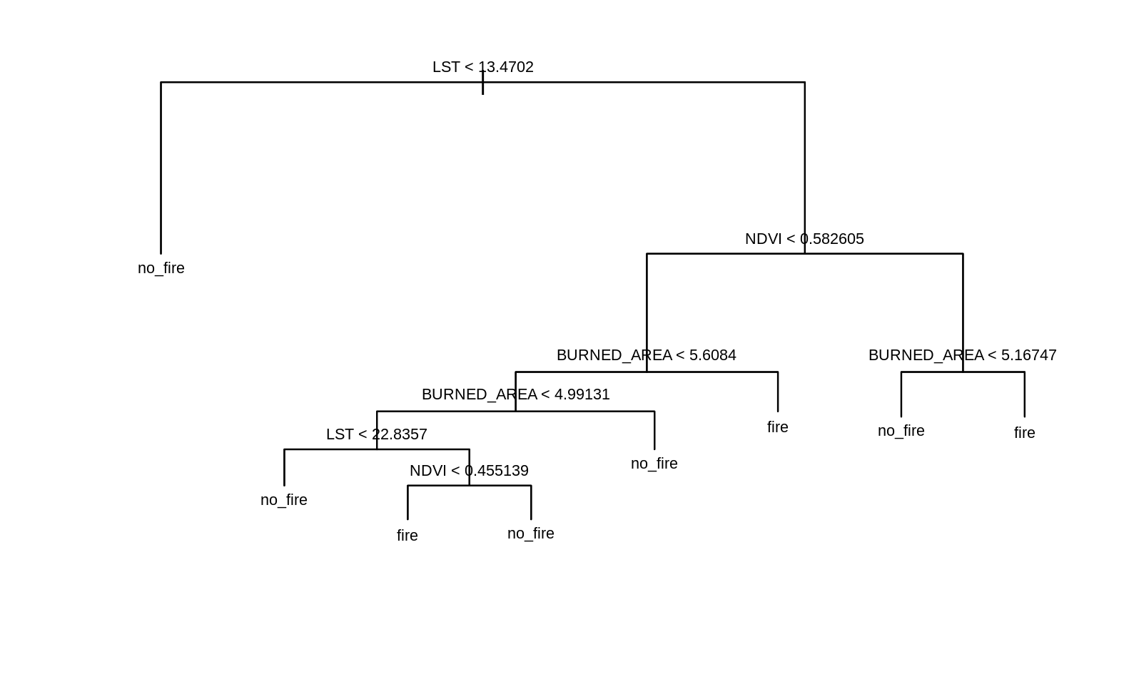
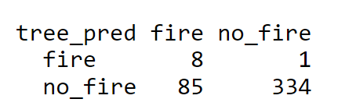
Wildfire Predictive Model
Predictive model evaluated with decision tree classification model
NDVI – Normalized Difference Vegetation Index. It is an index of a crop's photosynthetic activity "greenness“
LST – Land Surface Temperature (ºC). It is the combination of vegetation and bare soil temperatures and is used to detect water-stressed crops
BURNED_AREA – in km, estimated based on areas with thermal anomalies
Overall Misclassification Rate: 20%

Slide 20
Summary and Next Steps
Summary
Three drivers of wildfires were identified
Boreal Forests: spruce and fir trees commonly found here are highly flammable and fires spread easily in the understory of these trees.
Precipitation: A low moisture content in the air increases likelihood of fires while a high moisture content will lower the chance of fires.
Temperature: Higher temperatures experienced in the summer support burning as it reduces moisture in the air, grasses and trees.
Wildfires are mostly caused by lightning but there is need to create more awareness among humans.
The Provinces with the least occurrence of wildfires are Nunavut, New Brunswick, Prince Edward Island, and Nova Scotia. These Provinces could be seen as areas to invest in when wildfires are a concern.
Fires occur between the months of May and August with June having the highest number of fires. This is not surprising as these are the warmest months in Canada.
Next Steps
Predictive Model: it would be helpful to have a model that predicts the possibility of fire in an area and categorize the risk for these areas into low, medium or high risk.

Slide 21
Team Learning Objective – All
SN | Name | Objective | Status | Successful (Y/N)
1 | Cindy | Build and train model to predict likelihood of wildfires based on inputs of vegetation index, Land surface temperature and burned area. | Completed | Y
2 | Jelilat | Implemented parallelization using process pools Created visualizations using AWS QuickSight | Completed | Y
3 | Mogaji | Use AWS QuickSight and Athena for Mapping and geospatial visualization. Use Amazon Web Services (AWS) S3 for data storage and hosting. | Completed | Y
4 | Victor | Implement code parallelization us process pools Design a dashboard in AWS QuickSight and ArcGIS | Completed | Y

Slide 22
Reference
Government of Canada (2023), Public Health Update on the Health Effects of Wildfires, https://www.canada.ca/en/health-canada/news/2023/06/public-health-update-on-the-health-effects-of-wildfires.html
Wayne E. Cascio (2017); Wildland fire smoke and human health; National Health and Environmental Effects Research Laboratory, Office of Research and Development, US EPA, United States
LANDFIRE 2010 – Updated Data to Support Wildfire and Ecological Management (2010), https://www.researchgate.net/figure/Conceptualization-of-the-impacts-of-wildfire-at-varying-scales_fig1_315498378
SQL-Based ETL with Apache Spark on Amazon EKS (2023) https://aws.amazon.com/solutions/implementations/sql-based-etl-with-apache-spark-on-amazon-eks/
SQL-Based ETL with Apache Spark on Amazon EKS (2023), https://spark.apache.org/index.html
Predictive modelling of wildfires: A new dataset and machine learning approach, https://www.sciencedirect.com/science/article/abs/pii/S0379711218303941
https://cwfis.cfs.nrcan.gc.ca/ha/nfdb
https://www.sciencedirect.com/science/article/abs/pii/S004896971733512X
Forest Fires | National Forestry Database (ccfm.org)
https://www.researchgate.net/figure/Conceptualization-of-the-impacts-of-wildfire-at-varying-scales_fig1_315498378
https://natural-resources.canada.ca/home

